Slide 1

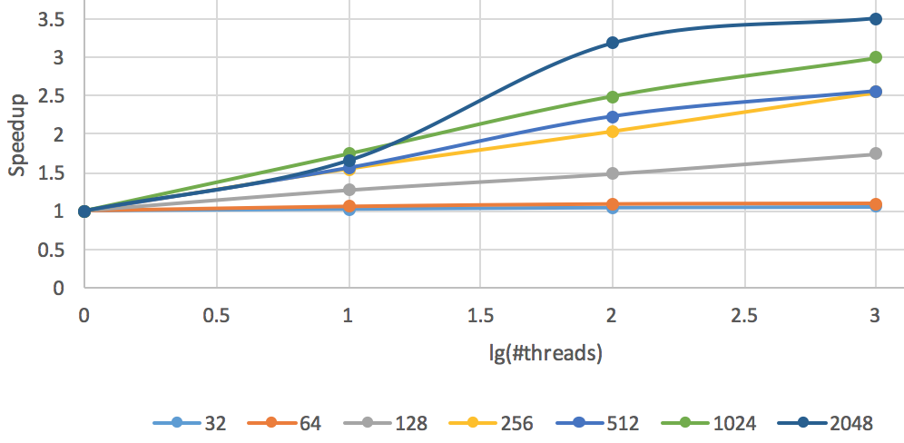
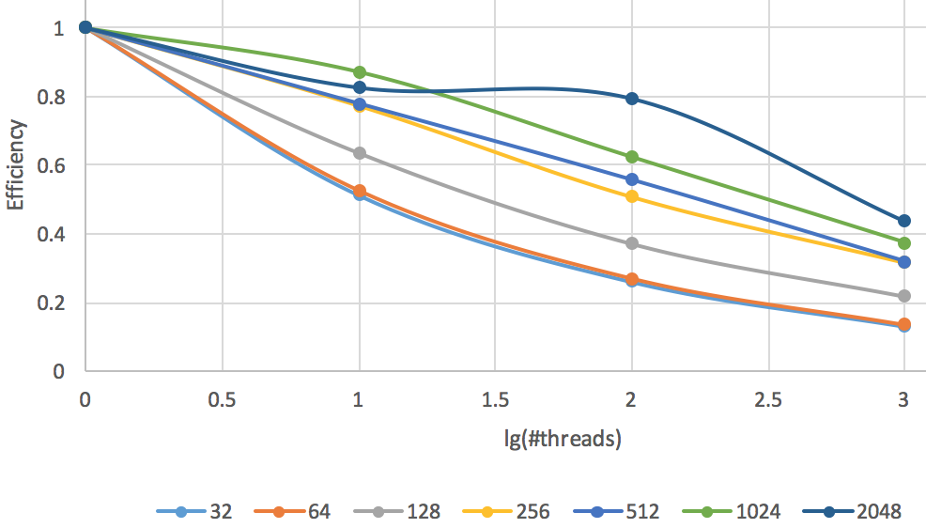
Parallel PageRank Estimator Using Adjacent List Jin Tao, School of EECS, Washington State University, Pullman WA (jin.tao@wsu.edu)
IMD
Proposed Approach
Main approach ideas: Targeted on shared memory system.
Use adjacent lists for graph representation to save space
Using static scheduling and atomic operation to balance the load and avoid race conditions
Starting from each node and then perform a walk of length K. Toss a coin at each step and compare with the damping ratio to determine if jumping to neighbors or jumping to any node. Based on damping ratio, if the node is dead-end, then jump out for a fair result.
Referenced from https://www.sycosure.com/wp-content/uploads/Google-PageRank-Check.png
Problem and Challenges
Main Outcomes
PROBLEM STATEMENT:
Input: Graph G(V, E) of web pages containing |V|=n nodes (webpage) and |E|=m edges
Output: A sorted array pr_sorted based on pr which contains n elements: pr[0], pr[1], …pr[i]…pr[n-1]; where pr[i] = the pagerank estimated for vertex i
SIGNIFICANCE: Page rank is utilized by today’s search engine to show high-quality results at the top of search engine listings.
CHALLENGES:
Achieving good load balance across all the threads/processors is challenging.
Avoiding possible race conditions is challenging.
Minimizing communication for distributed memory implementation is challenging.
Based on directed graph using web-Google.txt:
Walk length=2048, top 5 nodes are 163075, 597621, 504140, 819223 and 54147.
REFERENCES:
[1] Page, Lawrence, et al. The PageRank citation ranking: Bringing order to the web. Stanford InfoLab, 1999.
12/10/2017

